Slide 1

FoosBots
Critical Design Review

Slide 2
EE Team Introduction
Team Lead - Michael Thompson
Electrical and Computer Engineering
EE Team Lead/Overall Team Lead
Cole Mitchell
Computer Engineering
Johnny Enriquez
Computer Engineering
Slayter Teal
Computer Engineering
Team Purchaser

Slide 3
MAE Team Introduction
Jackson Law
Mechanical Engineering
ME Team Lead
Jonathan Harris
Mechanical Engineering
Team Planner
Alex Rivera
Mechanical Engineering
Hunter Collins
Mechanical Engineering Technology
Kenny Gipson
Mechanical Engineering
Garrison Locke
Mechanical Engineering Technology

Slide 4
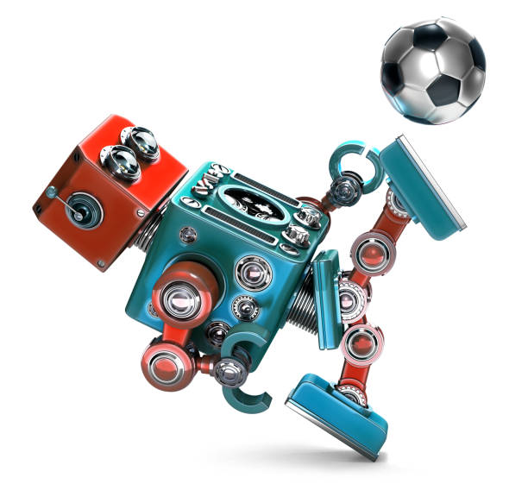
Problem Description
The objective of this project is to turn Foosball into an arcade-style game where a human player competes against a robot opponent. Our design will allow for further use as a teaching tool in a variety collegiate level scopes.
To achieve this, we will use computer vision, a finite state machine, a centralized data server, CAN communication and a robust mechanical design for stability and reliability.
Notes:
Our primary objective with this project is essentially to turn foosball into an arcade-style game where 1 or 2 human players can play foosball against a robotic opponent. This project is also intended to be a teaching tool for future OSU students to learn about mechatronics and programming in a variety of collegieate-level scopes.
In order to meet these goals, we will be using computer vision for ball tracking, a finite state machine for the brain, a centralized data server, CAN communication, and a simple, robust mechanical actuator design for stable and reliable gameplay.

Slide 5
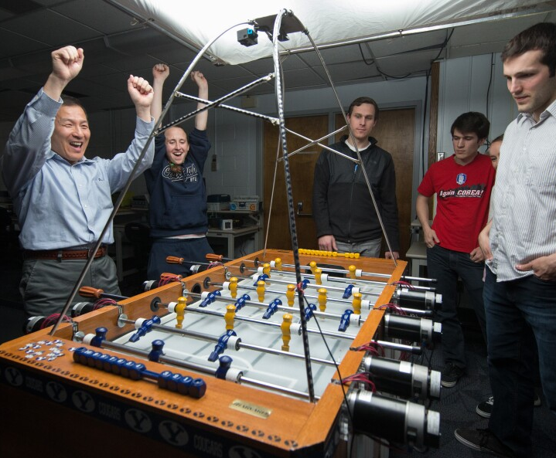
Project Deliverables – Mechanical
Camera Stand
Rotational Actuation Device
360 spinning
Linear movement
Actuation Table
Table houses Roto-Linear Actuators on top
Electronics and controls below
Acrylic Wall
Rod Covers
Change players
Paint table

Slide 6
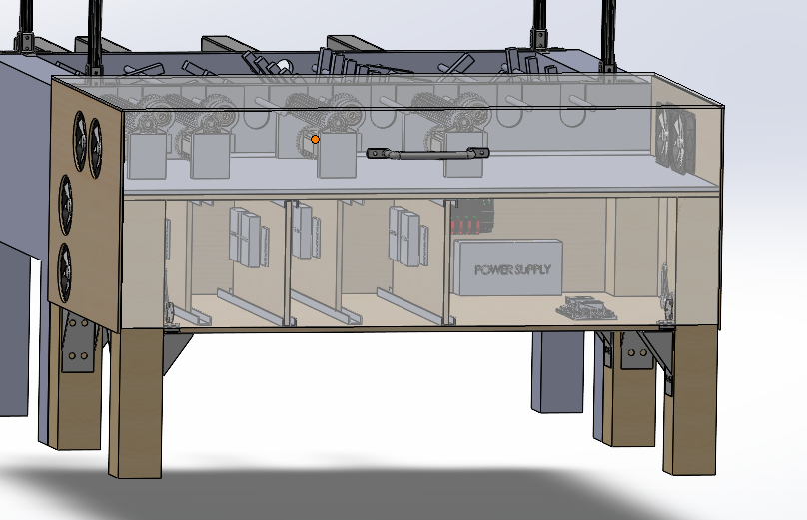
Project Deliverables – Electrical
Goal sensors
Scoreboard
Start/Stop button
Ball Detection/Location
Location of the ball
Velocity vector
AI/Brain
Respond to ball
Kick slow moving ball
Controls
Robot player response
Correctly follow commands
Motor Power Switch
Power—Wall plug-in
Modularity
Notes:
On the electrical side, we need Goal Sensors for score tracking,
A scoreboard for score reporting and our GUI
We will use a computer vision algorithm for ball tracking and basic prediction
Our finite state machine will respond to and kick balls back toward the human goal and should be able to respond to a ball moving a minimum of 2 m/s
For controls, we will need to make our motors move and respond to commands correctly, as well as including a power switch for the motors which can also function as an emergency stop
For power we’re just going to use a simple wall plug in.
The most important aspect of this whole design is modularity. So when the design is all said and done, all of our components should be almost plug-and-play, with limited
Adjustments being necessary to change components or if a future team wanted to expand on the design that will also be very easy to do.

Slide 7
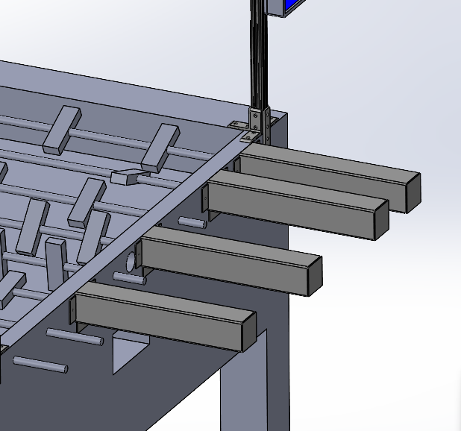
ENVIRONMENTAL HEALTH AND SAFETY CONCERNS
Safety Concerns:
Impact Hazard from fast-moving rods
Pinching Hazard between rod bumpers and the sidewall/possible fingers in unshielded motors
Safety Strategies:
Rod Covers
Acrylic Panels
Emergency Stop
Fabrication Safety:
Proper PPE
Follow Machine Shop guidelines/ask questions if unsure
Environmental Concerns:
We will be using a lot of 3D printed parts and it is important to dispose of waste materials properly.
We also want to minimize any additional waste from the fabrication of our other parts as well.
Notes:
As we all learn at our NCL machine trainings. Machines do what they are told, regardless of whether or not your hand is in the way.
Our table is the same way, and there are some impact hazards from fast-moving rods, and a risk that someone might get pinched if they reach into the table without warning.
To prevent this, we will be including welded rod covers on the human side of the table to prevent any impacts from fast-moving rods.
Additionally, we will have acrylic panels on the sides of the table to prevent someone putting their hand in accidentally.
We will also include a power switch directly to the motors to function as an emergency stop
As far as fabrication goes, the main things are PPE
-gloves, static mats, grounding
-common sense, machine shop guidelines, and ask questions.
We’re also going to be using several 3d printed parts to complete our design, so we want to make sure we dispose of any waste plastic in a safe manner
PLA is technically biodegradable, but that process takes a long time and that plastic can still be ingested by wildlife and cause them harm.
We also want to limit any other waste in the fabrication of our design and dispose of all generated waste safely and properly.

Slide 8
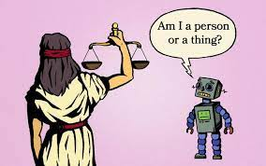
Global, Ethical, and Cultural Considerations
Recreation is an important market because it allows people to blow off steam and be distracted from daily life for a bit.
This table will allow people to play foosball by themselves without a partner
This table could allow people to play with a partner over long distances if each person has a table.
Possible Negative Outcomes
Over competitiveness
Engineering too well
Project Stakeholders
OSU CEAT
Foosball Industry
Mechatronics Hobbyists

Slide 9
Engineering Principles
The principles listed below are things we've learned through the years and will apply to our design in order to complete the task at hand.
Solidworks/CAD
Dynamics
Statics
FEA Analysis
Python
Circuits
Software Encapsulation
Software Abstraction
Software Modularity
Extensive Documentation

Slide 10



Mechanical Standards
Standards currently being applied in Design
ASME Y14.5-2018
Geometric Dimensioning And Tolerancing
ANSI/NEMA MG 1-2016
Stepper Motors, proper selection and application
ASME Y14.1 – 2020
Engineering Drawing Practices
ISO 17396
Principle Belt Drive Selection

Slide 11

Electrical Standards
Articles
110: Basic Requirements
200 : Use of proper identification for grounded wires
210.20 : Have an amp rating of 125% of the amps needed
250.4 : Electrical equipment must be grounded
430.4 : Part winding motors
460 : Proper use of Capacitors
470 : Proper use of Resistors

Slide 12



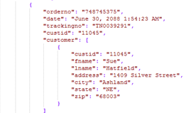
Software and Communication Standards
Python 3
PEP 8 – Style Guide
Git – Version Control
RFC 793
TCP – reliable messaging among processes
ECMA 262
JSON
ISO 11898
CAN Communication
RS-485
5V UART

Slide 13


Project Design

Slide 14
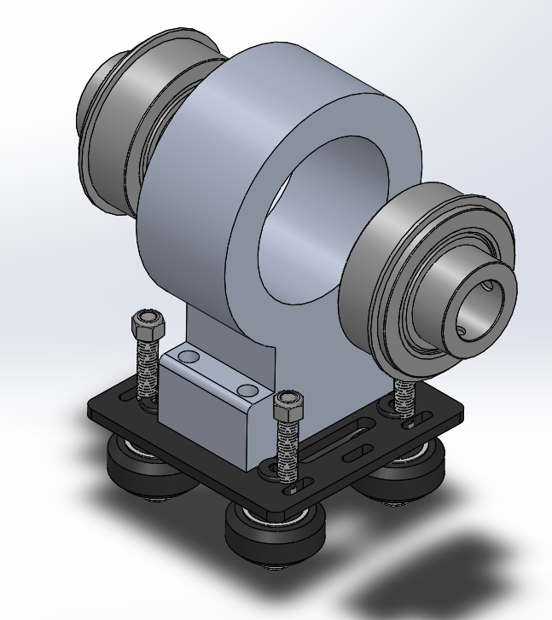

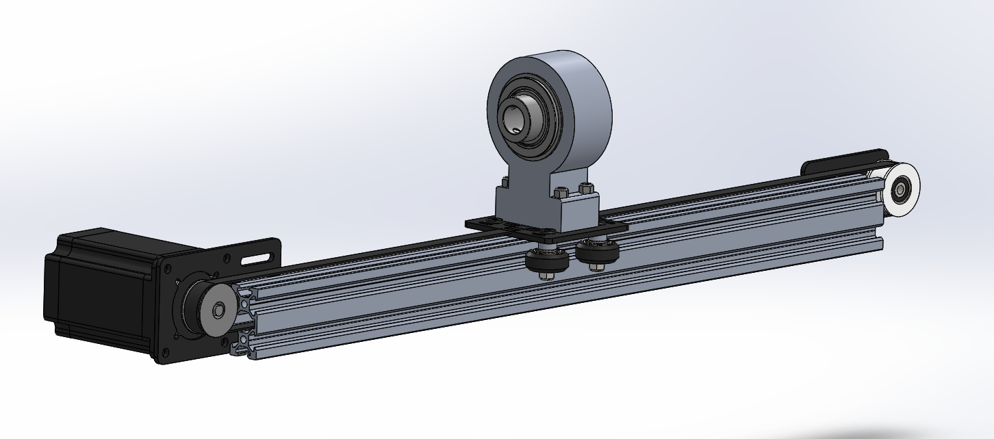
Linear Motion
Belt/Sled Driven System
Linear actuation kit retrofitted to withstand high torque Nema 23 Motor
Frictionless gantry slotted onto V-Slot Channeling
Rod Attachment
Custom aluminum housing for 2 set screw collar ball bearings

Slide 15
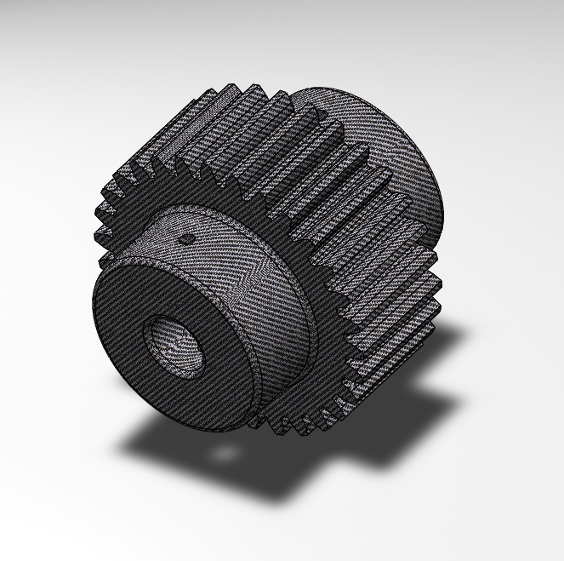
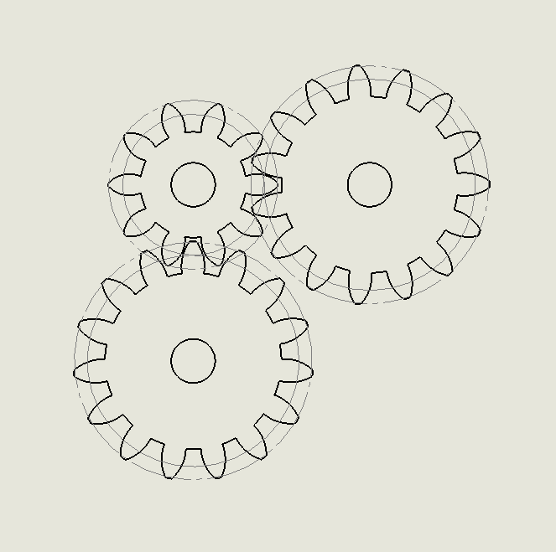

Rotational Motion
Rotational motion will be driven by 3 gears, one attached to the motor, second is the spline, third is the gear on the pole itself.
The two gears will be made by ONYX 3D printing, and the spline shaft will be made out of slippery UHMW plastic.

Slide 16
Actuator Table
Table will be constructed from wood framing and plywood paneling
Rod Actuators will be housed in the top section of the table
Processors, Drivers, Controllers, and Power Supply will be housed inside the table.
Advantages:
Greater Stability
Easier access to electronic components
Notes:
The actuator table is going to be constructed using 4x4 and 2x4 lumber framing with plywood paneling for the sides and mounting surfaces.
The motors and rod actuator assemblies will be housed in the top section of the actuator table, and the Processors, drivers, controllers, and
power supply will all be housed below in the lower section of the table
This design has several advantages.
It’s going to be very stable due to the large weight.
We’ll be able to access electronic components more easily for modifications/ repairs.
And because all our mounting surfaces are wood, it’s also much easier to make adjustments to where our components mount on the table if we make a mistake
We’re also going to include rubber padding between the foosball and actuator tables dampen any vibratons

Slide 17
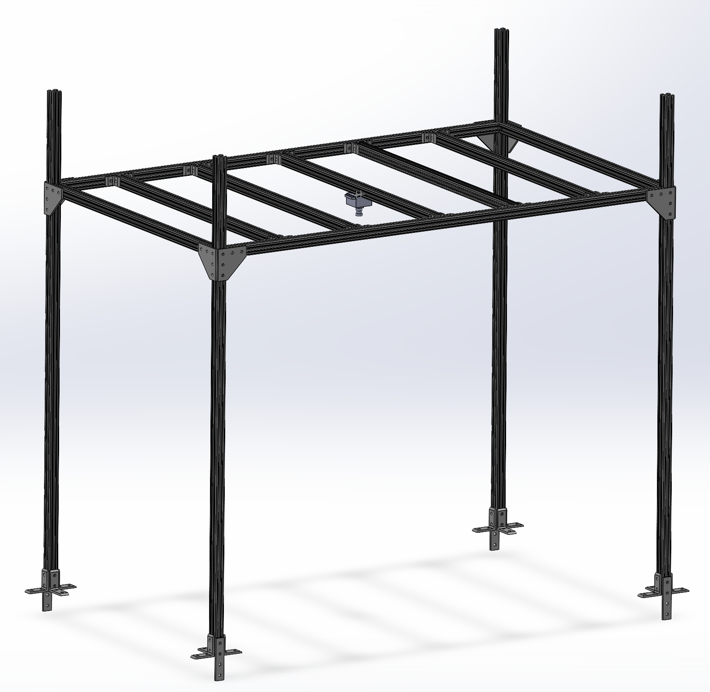
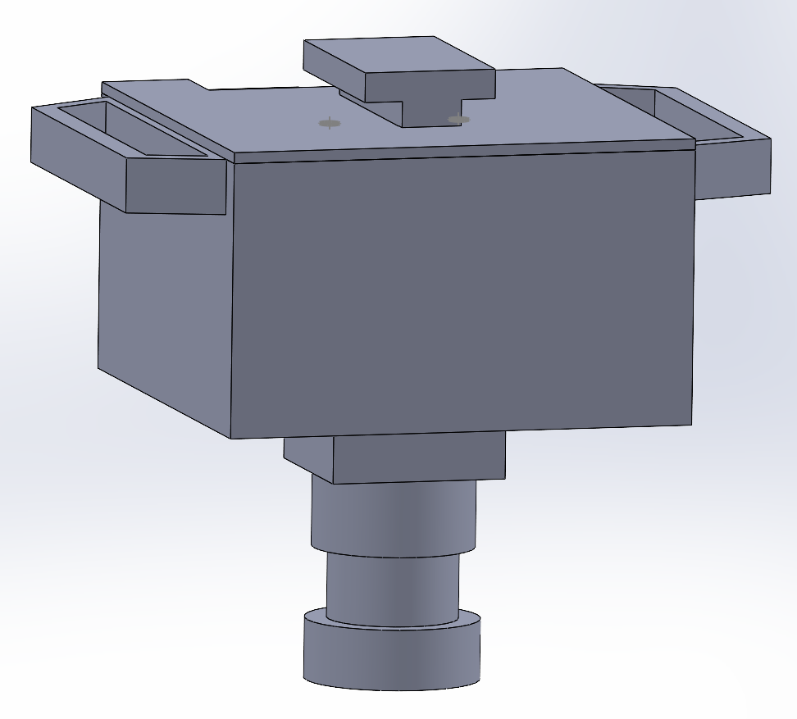
Adjustable Frame with Camera Mount
The frame that the camera is mounted to is constructed from 1-inch T-Slotted Aluminum Railing and has the capability to adjust its height to ensure the camera can capture the entire play area. The camera mount is press fit to the railing and the railing attaches to the table via the angle brackets at the bottom.

Slide 18
Electrical Design

Slide 19
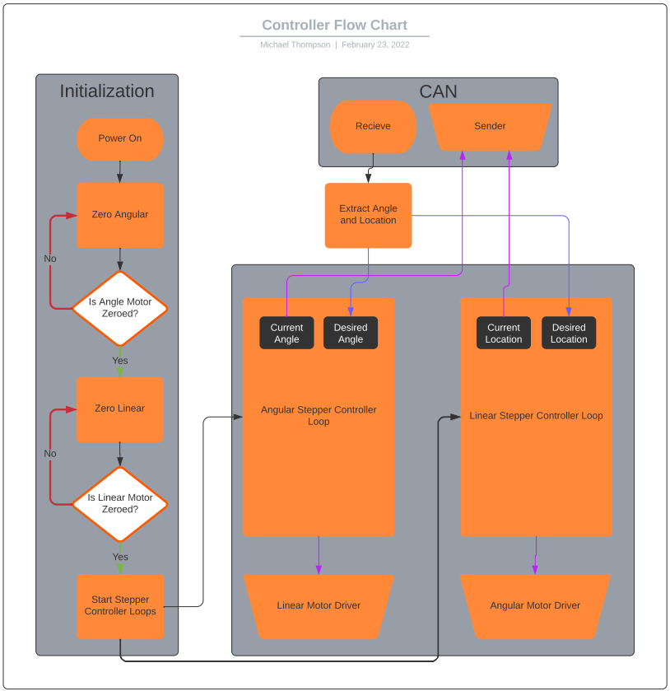
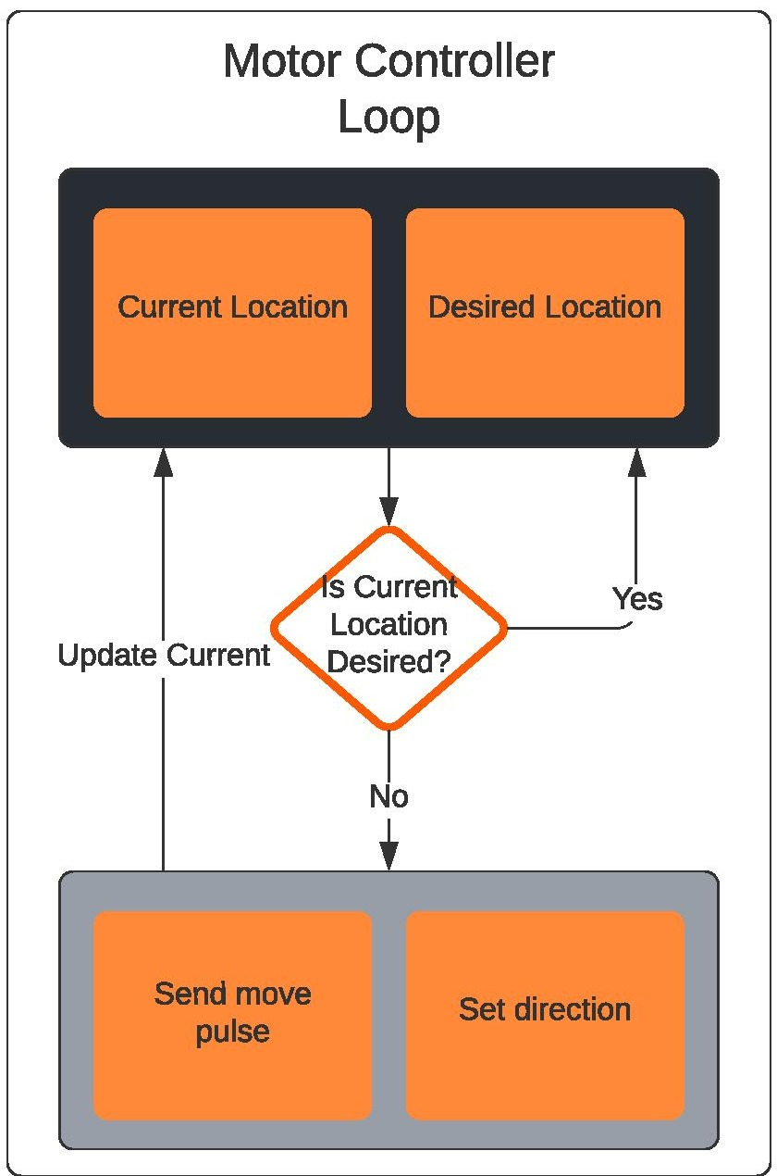
Control

Slide 20
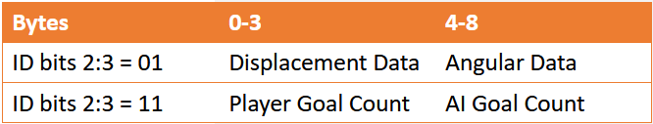
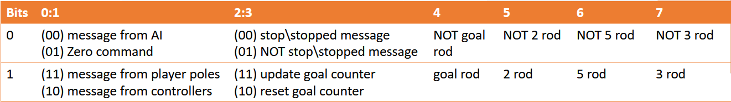
CAN Communication
Messages in priority order:
Stop
Movement
Zero
Location
Stopped
Reset Goals
Goals
Data
Identification

Slide 21
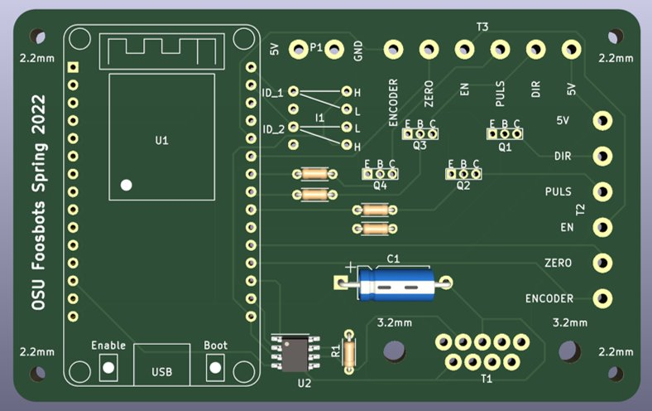
Controller PCB
Max current of 142.5mA needs a minimum trace width of 0.0532mm. The default is 0.25mm which is larger than the minimum.
Needs
CAN SOIC Package
Open Collector NPN BJT
Benefits
2 ID pins
DB-9 connector
Motor Driver Screw Terminals
Sensor Screw Terminals
Encoder Screw Terminal

Slide 22
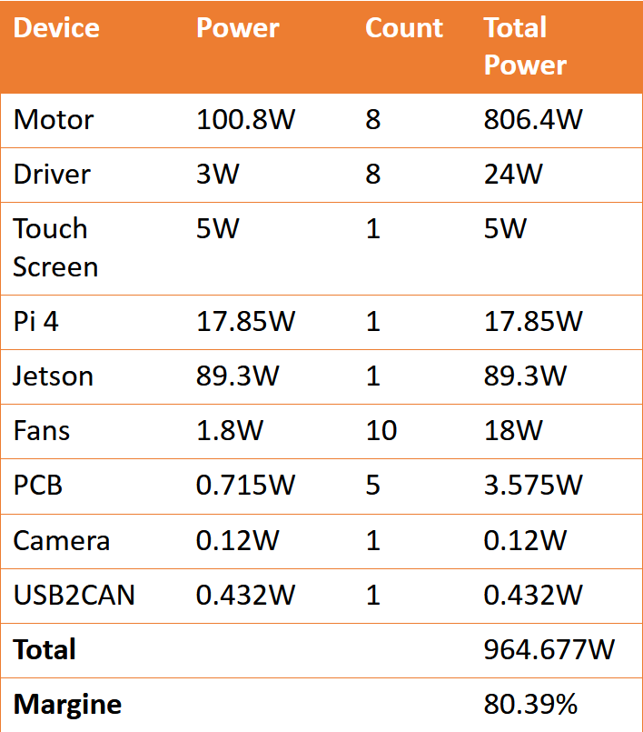
Power
Supply: 24V 1200W
Step Downs : 12V and 5V
Manufacturer Recommends 80% load

Slide 23
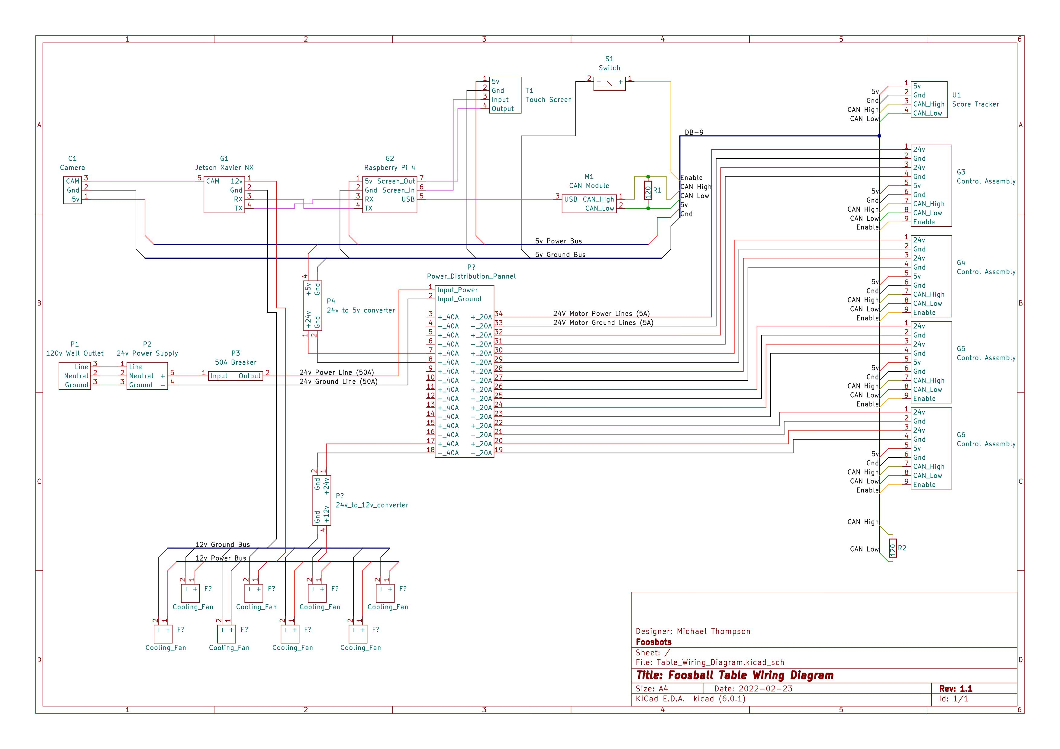

Slide 24
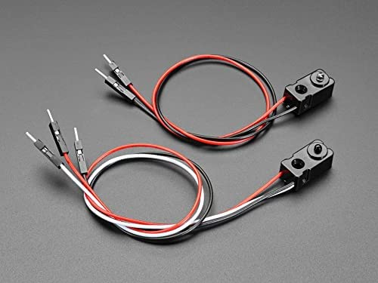
Goal Tracking
Break Beams
Set up two sensors on each side
Will sense an object pass using IR light
Sends a signal to the CAN bus to track the score

Slide 25
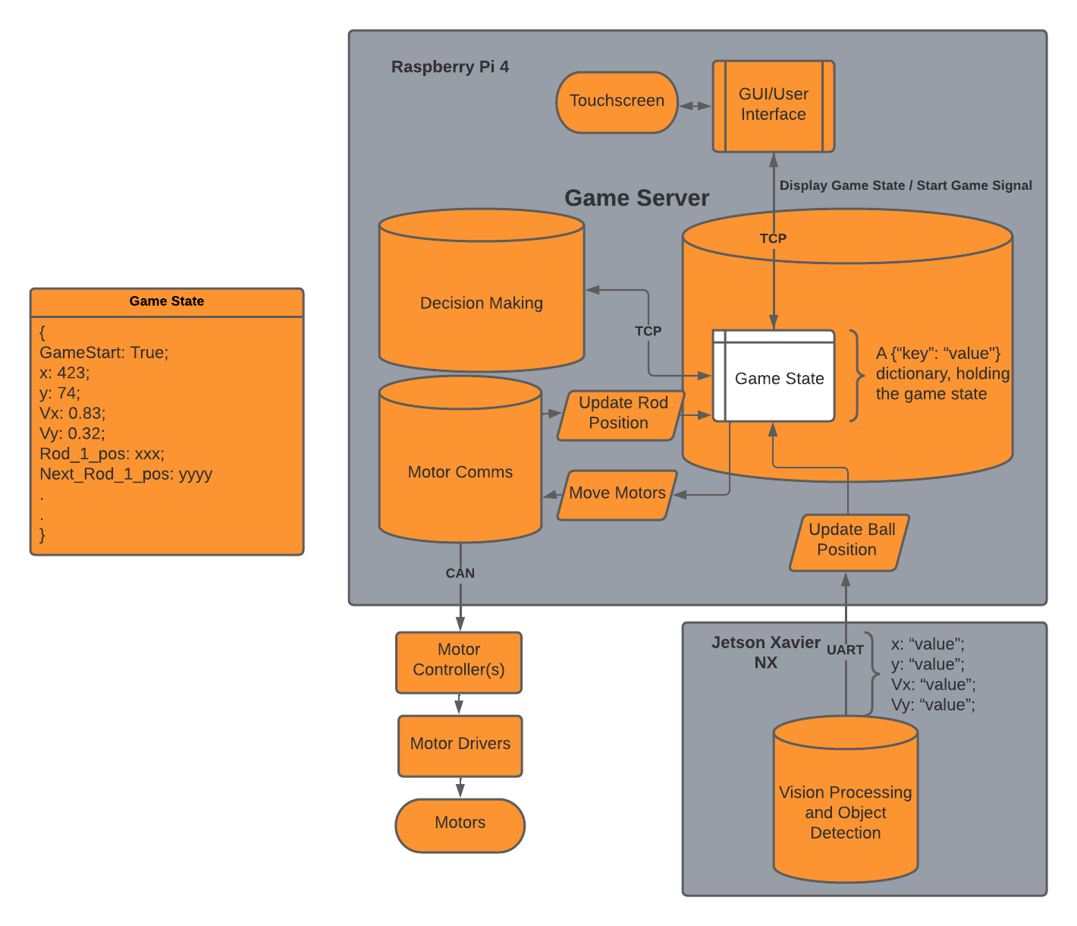
Software Organization and Structure
Notes:
There are other types of image processing that would also work such as:
Marr-Hildreth algorithm
An early form of edge detection.
SIFT (Scale-invariant feature transform)
An Algorithm to detect and describe local features in images
Neural network based image processing
Which is a tad overkill for the project.

Slide 26
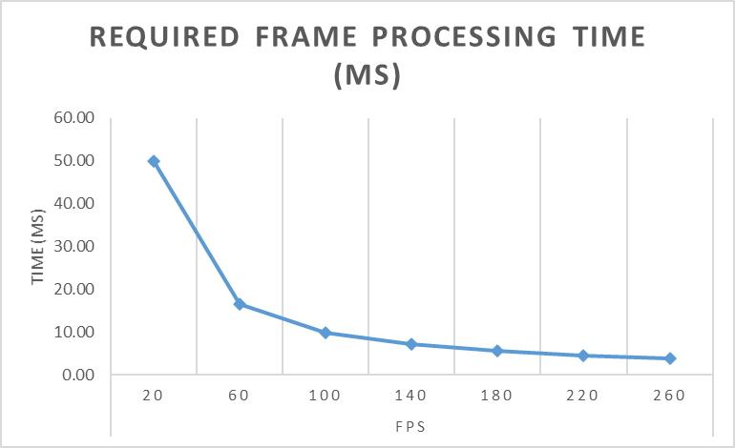
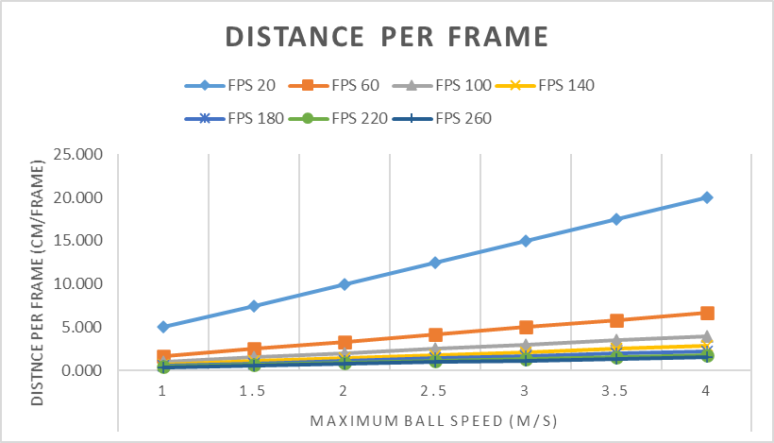
Vision and Perception
Goal:
Locate the ball on the playing field and deliver the balls location and velocity vector to the main computer, updating the game state.
Constraints:
Balancing processing time and frame rate, staying under a 10ms processing time (100fps).
What am I finding?
Ball Position (X, Y)
Ball velocity vector (Vx, Vy)
Notes:
There are other types of image processing that would also work such as:
Marr-Hildreth algorithm
An early form of edge detection.
SIFT (Scale-invariant feature transform)
An Algorithm to detect and describe local features in images
Neural network based image processing
Which is a tad overkill for the project.

Slide 27
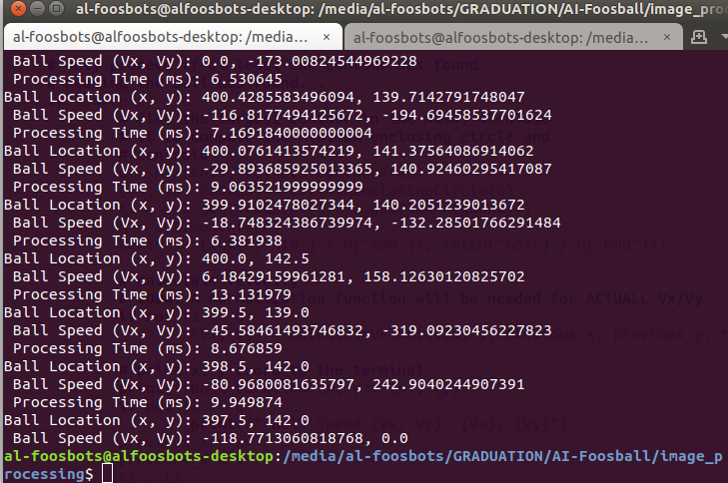
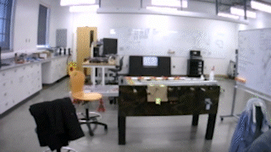
Vision and Perception
Normalization Function
Correct Fish-eye
Establish pixel-to-cm function
Notes:
There are other types of image processing that would also work such as:
Marr-Hildreth algorithm
An early form of edge detection.
SIFT (Scale-invariant feature transform)
An Algorithm to detect and describe local features in images
Neural network based image processing
Which is a tad overkill for the project.

Slide 28

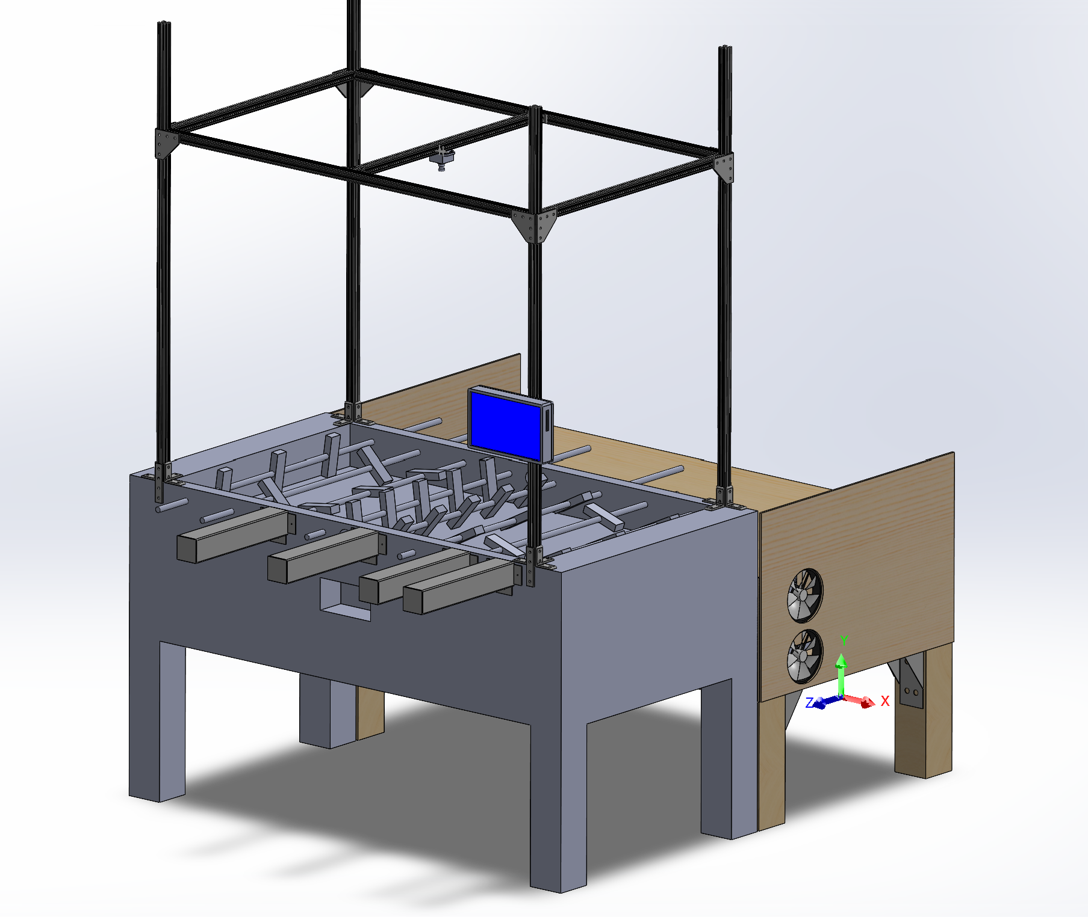

Graphical User Interface
A way for the user to interact with the table and view the state of the game.
Using a touch screen mounted to the posts of the table.
The screen will allow users to start/stop the game and view the score of the current game.
Designed using ElectronJS, a popular cross-desktop application.
Notes:
There are other types of image processing that would also work such as:
Marr-Hildreth algorithm
An early form of edge detection.
SIFT (Scale-invariant feature transform)
An Algorithm to detect and describe local features in images
Neural network based image processing
Which is a tad overkill for the project.

Slide 29
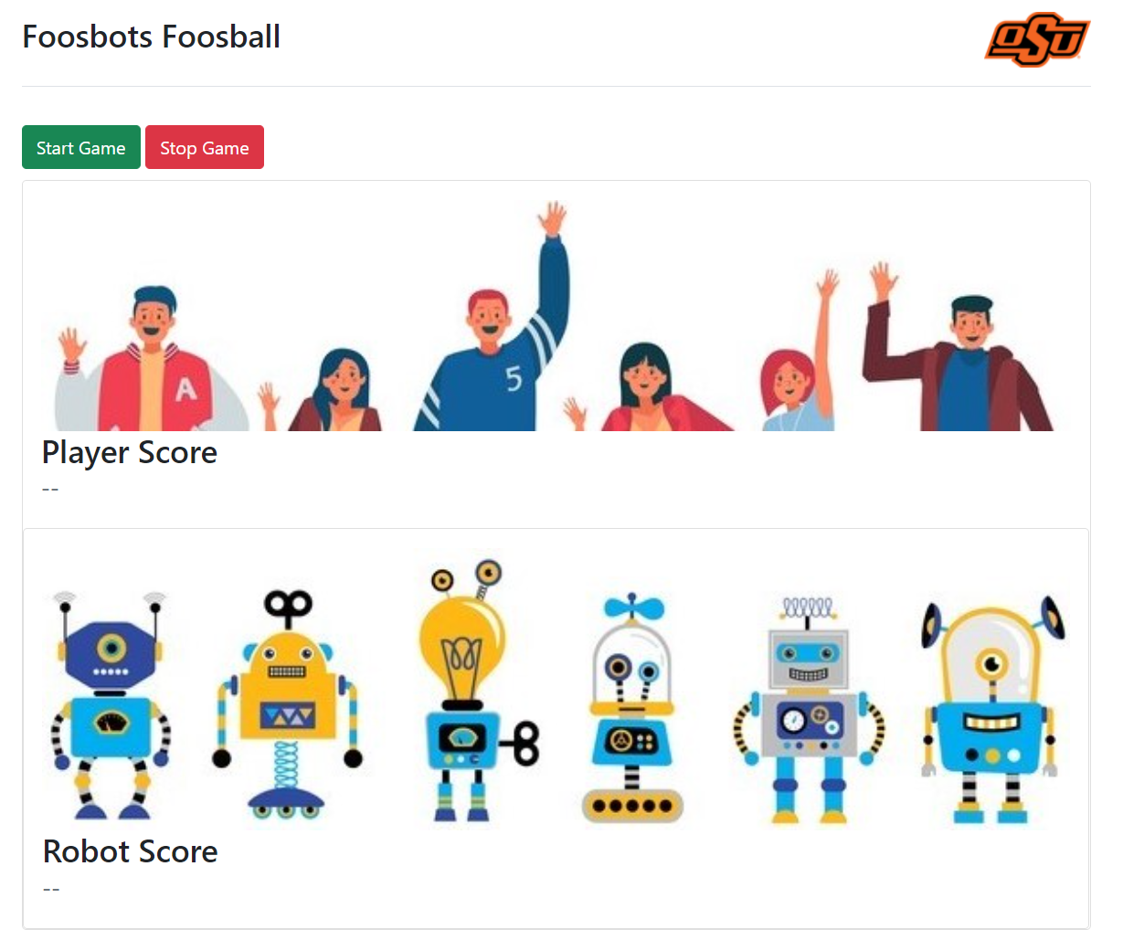
Notes:
There are other types of image processing that would also work such as:
Marr-Hildreth algorithm
An early form of edge detection.
SIFT (Scale-invariant feature transform)
An Algorithm to detect and describe local features in images
Neural network based image processing
Which is a tad overkill for the project.

Slide 30
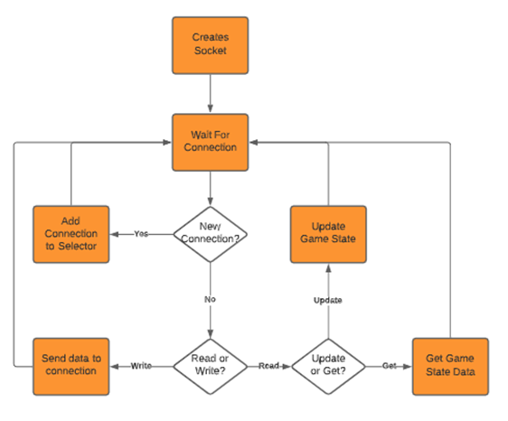
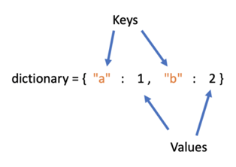
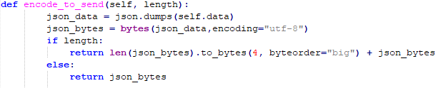
Server

Slide 31
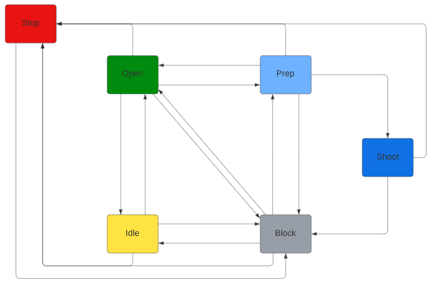
Finite State Machine
Stop – Outputs no motor command, triggered by an external signal
Idle – Sets the rod to a standard position when the ball is far away
Open – When the ball is behind the rod, the players are parallel with the table
Block – When the ball is in front of the rod, players stand vertically and move to position themselves between the ball and the goal
Prep – If the ball approaches at a desired speed, angles player back and positions to direct the ball towards the goal
Shoot – Swings the player forward

Slide 32
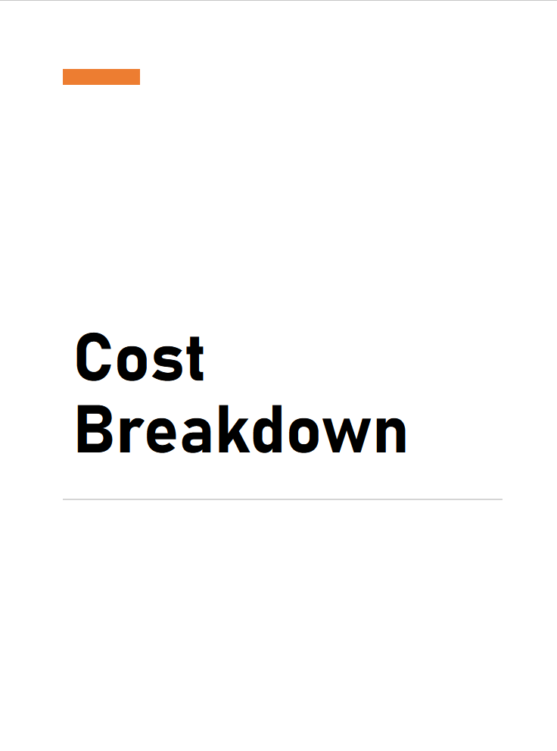
Cost Breakdown
Total Budget: $10,000
Planned Expenses: $5,993.79
Mechanical: $3,008.70
Vision Framing - $639.24
Rotational - $663.70
Linear - $747.24
Table - $956.52
Electrical: $2,921.17
Variance: 40% Underbudget or $4,006.21 Remaining
Processors - $2162.32
PCB - $233.09
Power - $330.31
Peripherals - $195.45

Slide 33

Knowledge Acquisition —Testing and Quality Assurance

Slide 34
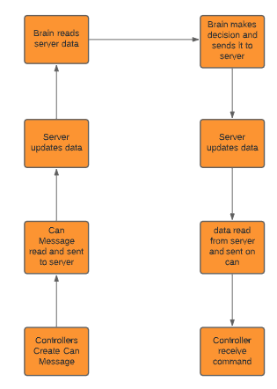
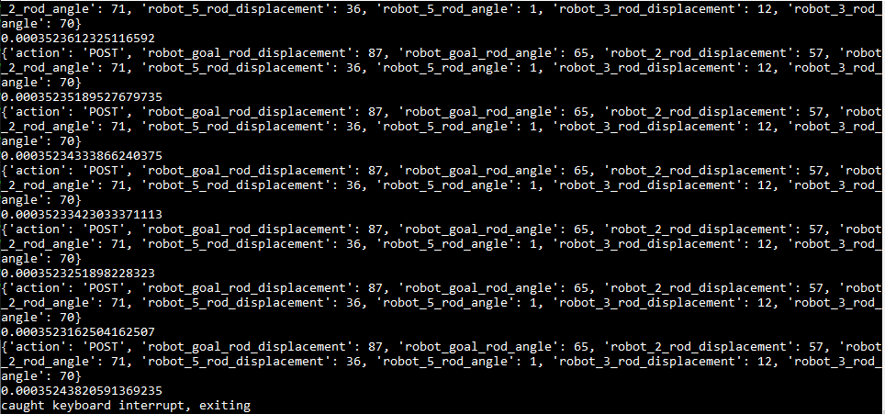
Software Knowledge Acquisition and Testing
Timing is the key unknown that needs to be accounted for.

Slide 35
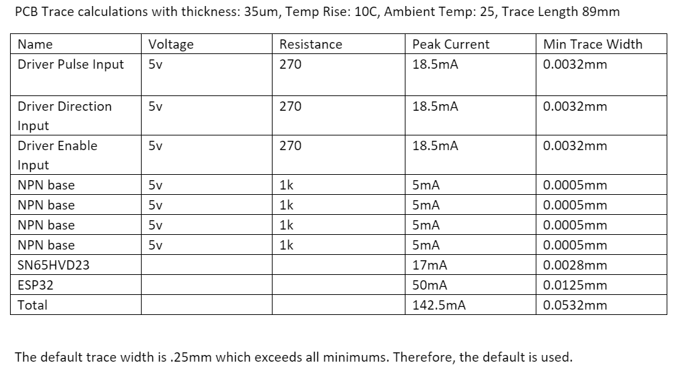
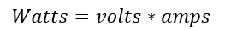
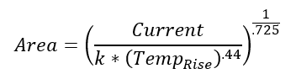
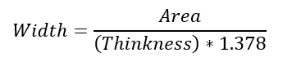
EE Hardware Knowledge Acquisition and Testing
For testing motor speed, we used a potentiometer to increase speed until the motor stopped.
Equations used:
Power consumption:
Trace calculation:

Slide 36
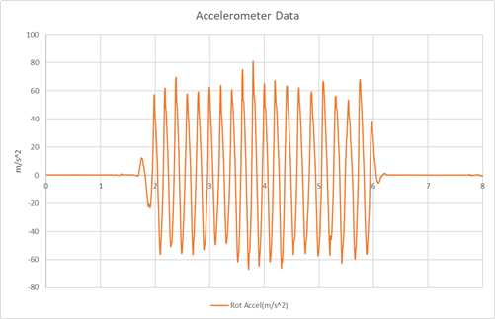
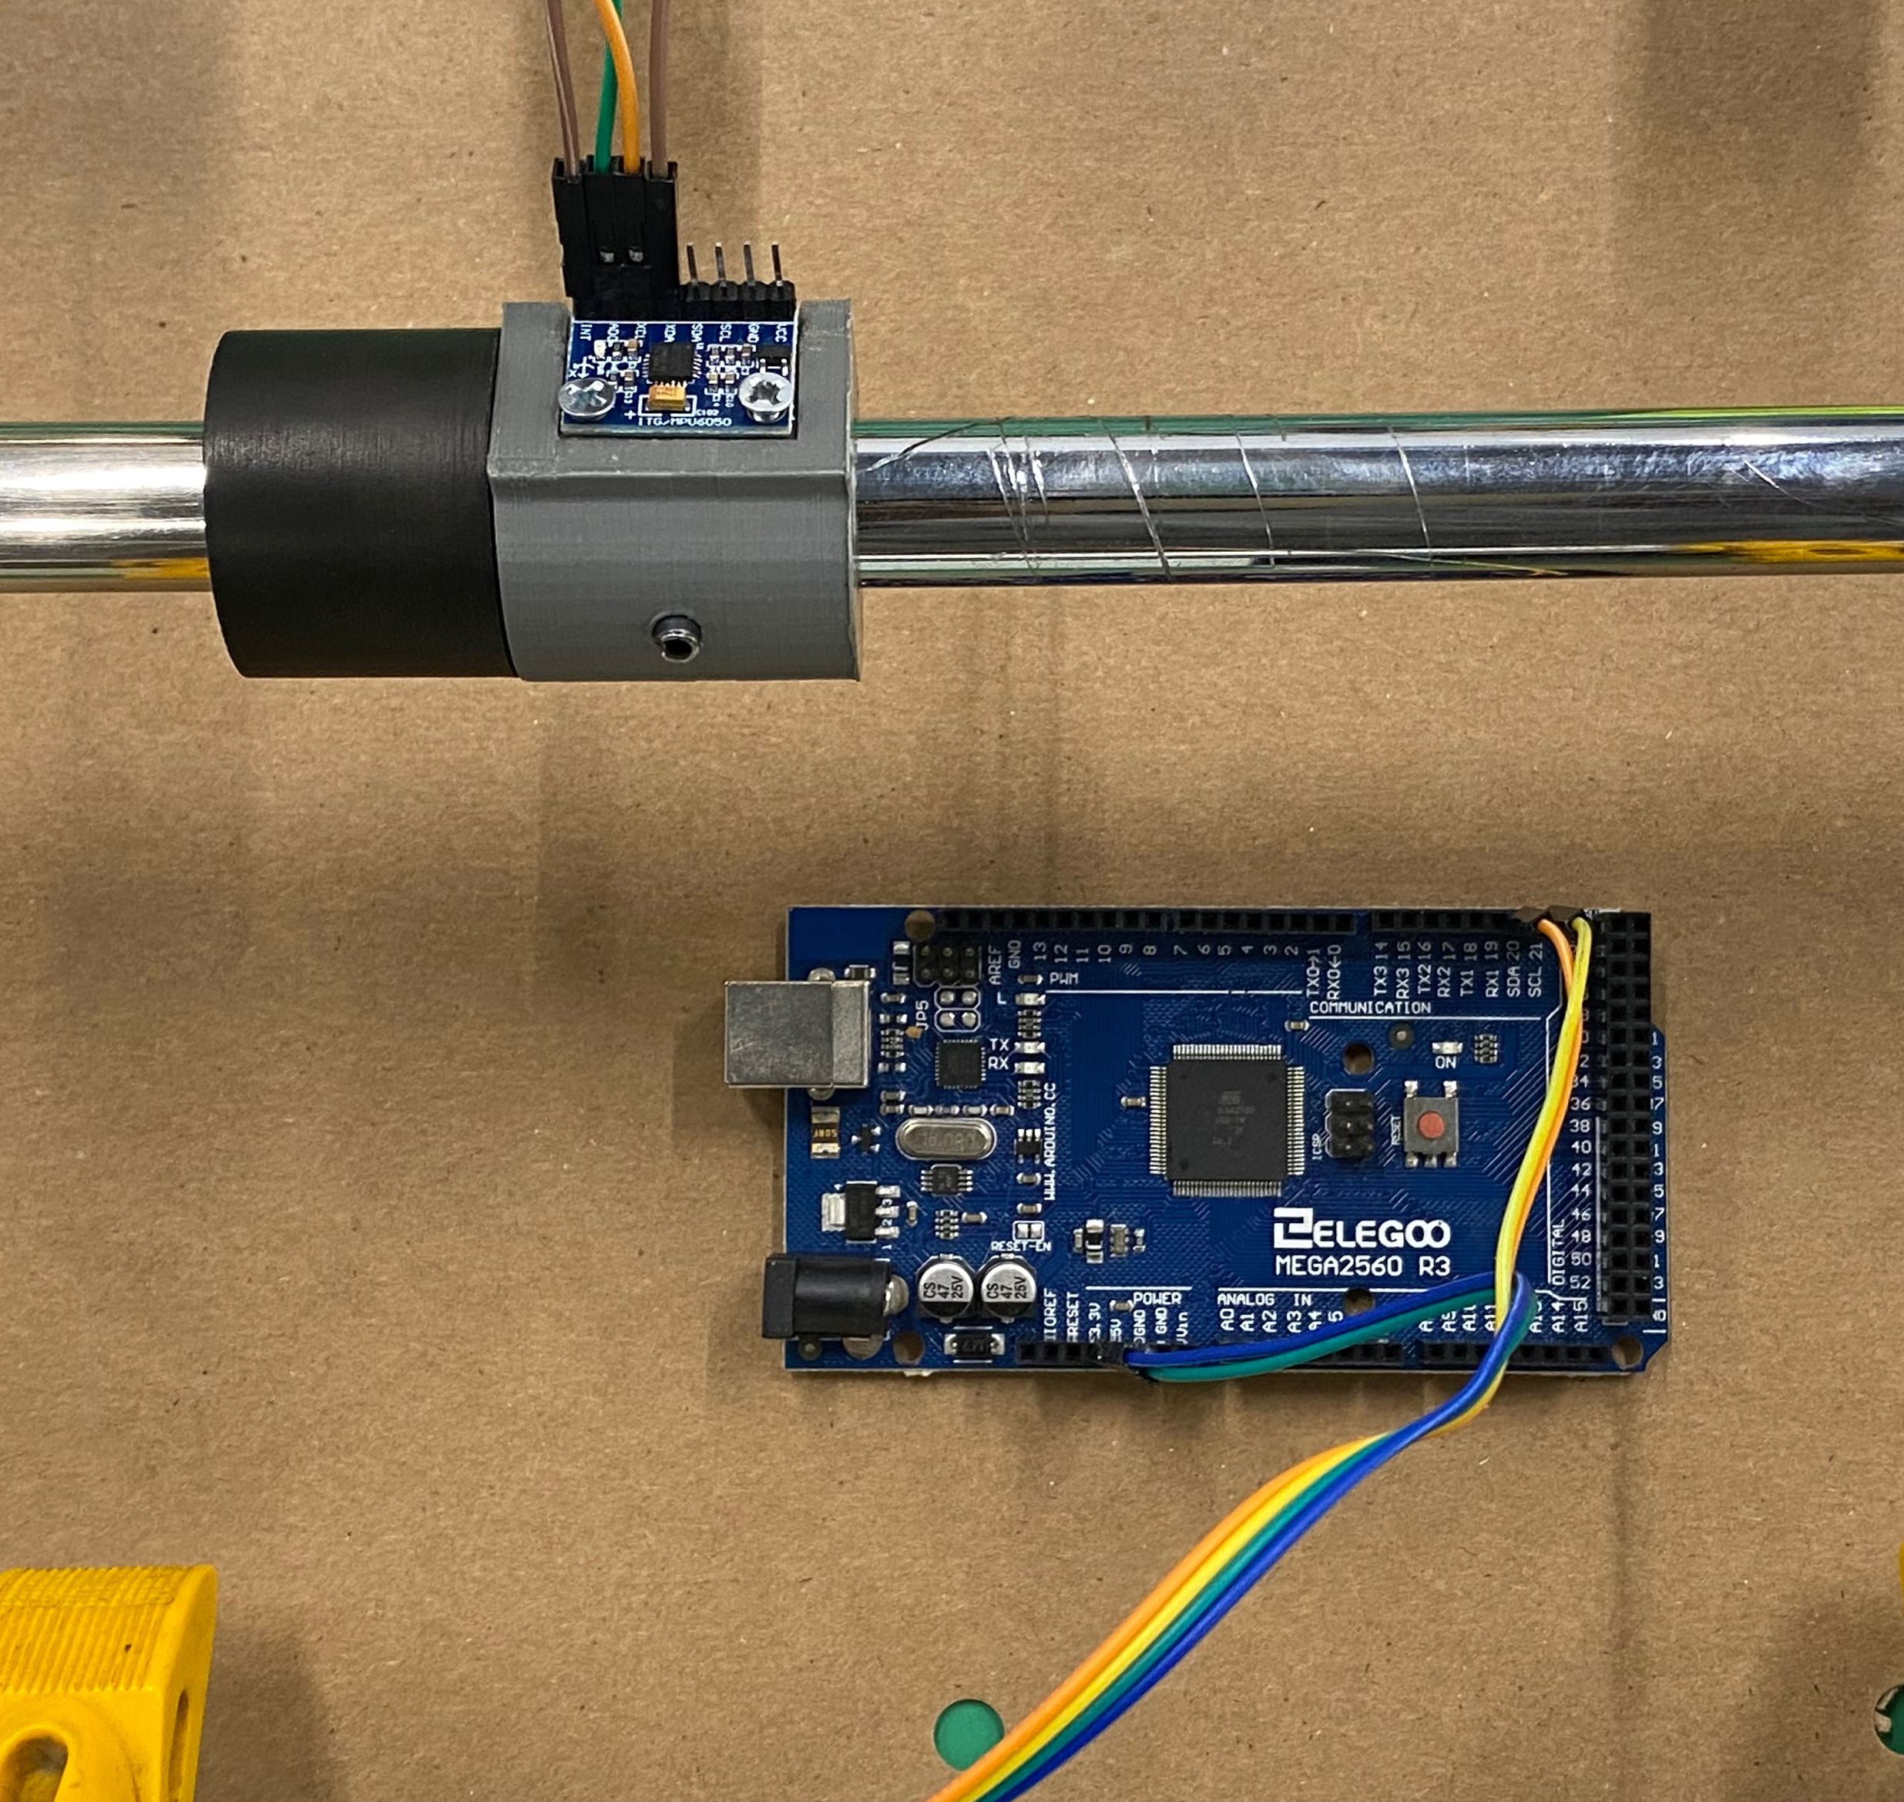
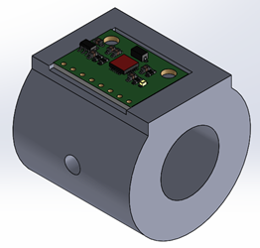
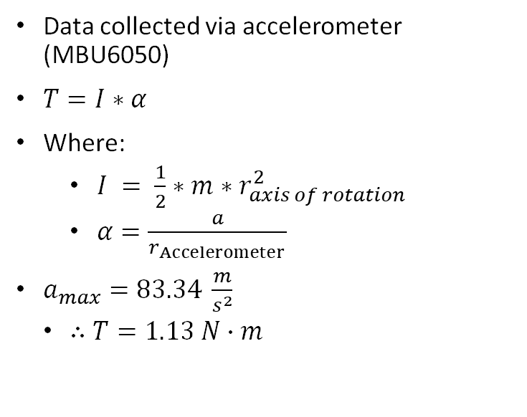
Rotational Motor Torque
Data collected via accelerometer (MBU6050)
$T=I∗α$
Where:
$I = \frac{1}{2}∗m∗r_{axis of rotation}^{2}$
$α=\frac{a}{r_{Accelerometer }}$
$a_{max}=83.34 \frac{m}{s^{2}}$
$∴T=1.13 N∙m$

Slide 37
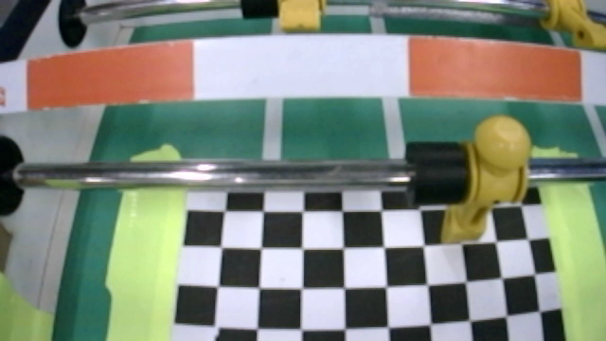
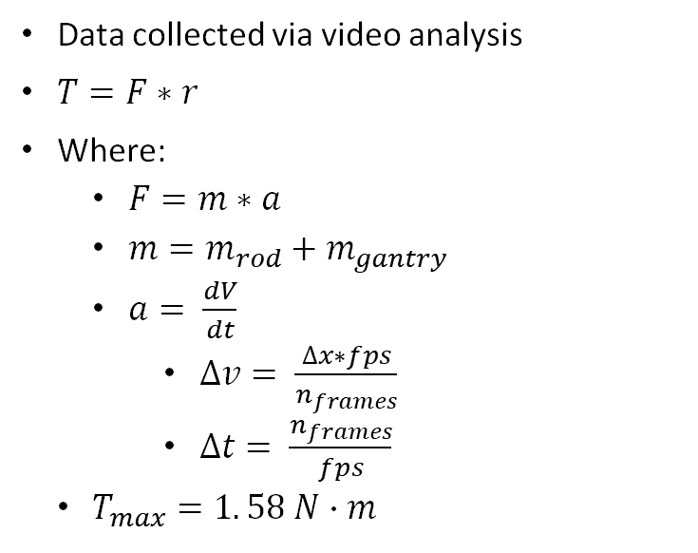
Linear Motor Torque
Data collected via video analysis
$T=F∗r$
Where:
$F=m∗a$
$m=m_{rod}+m_{gantry}$
$a= \frac{dV}{dt}$
$∆v= \frac{∆x∗fps}{n_{frames}}$
$∆t= \frac{n_{frames}}{fps}$
$T_{max}=1. 58 N∙m$

Slide 38
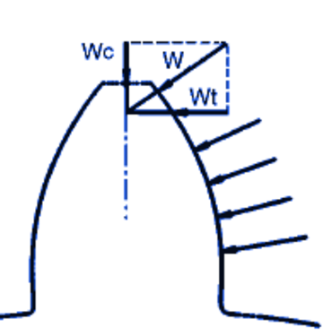
Gear Tooth Strength Calculation
Spline Teeth Calculation (Slippery UHMW Polyethylene)
S = 1867 psi, F = .250 in, Y = .340, D_{p}= 5 in
W_{t}= [ S * F * Y] / D_{p} = [1867 *.250*.340] / 5 = 170 N.
Gear teeth Calculation (ONYX)
S = 1700 psi, F = .500 in, Y = .28, D_{p}= 5 in
W_{t}= [ S * F * Y] / D_{p} = [1700 *.500*..280] / 5 = 47.6 N

Slide 39
Materials
6061-T6 Aluminum rods
The fatigue life of the rods was calculated to find if the metal would shear if too much rotational force was applied.
Aluminum is a both lightweight and flexible with high corrosion resistance
Onyx for the gears
The reason we chose onyx for the gears is the cost benefit for using the material since it is offered to us by the 3-D printing lab. We save 211.72 dollars using onyx instead of ordering aluminum 6010 gears.
Slippery UHMW Polyethylene Rods
Excellent resistance to stress and high resistant to cracking
15 time more resistant to abrasion than steel.

Slide 40
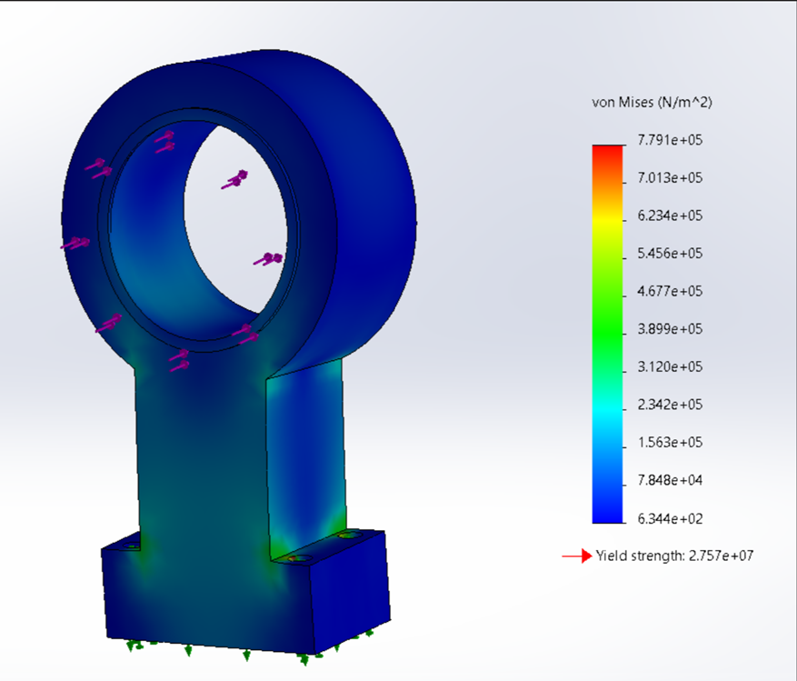
FEA Analysis of Arm Attachment
According to the FEA analysis done on the arm attachment, the shear force that will be expended on it is well below the yield strength. In conclusion the arm attachment should be able withstand the forces acting upon it

Slide 41
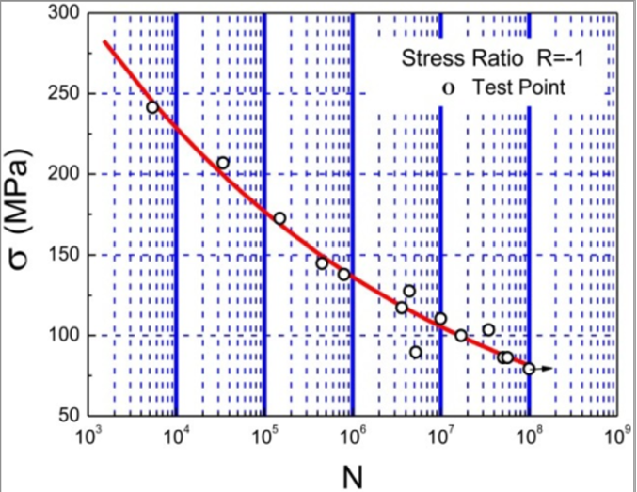
Aluminum Rod Fatigue Calculation
S_{ut}=290 MPa, C_{load}=1, C_{temp}=1, C_{reliabilty}=.897
S_{e}=C_{load}* C_{surf}* C_{size}* C_{temp}* C_{reliabilty}*S_{e}’ (1)
C_{size}= 1.189 * d ^{-.97} = 1.189 * (15.7) ^{-.97} =.91028
C_{surf}= 4.51 * S_{ut}^{-.265}= 4.51 * (290)^{-.265} =1.00378
S_{e}’ = .5 * S_{ut} = .5 * 290 = 145MPa
S_{e}= 1 * .91028 * 1.00378 * 1 * .897 * 145 = 118.84MPa = 17236.28 psi
S_{m}= .9(290)= 261MPa
Using the S-N curve graph we find that our fatigue strength is 94.5 MPa and N= 3500000 cycles

Slide 42
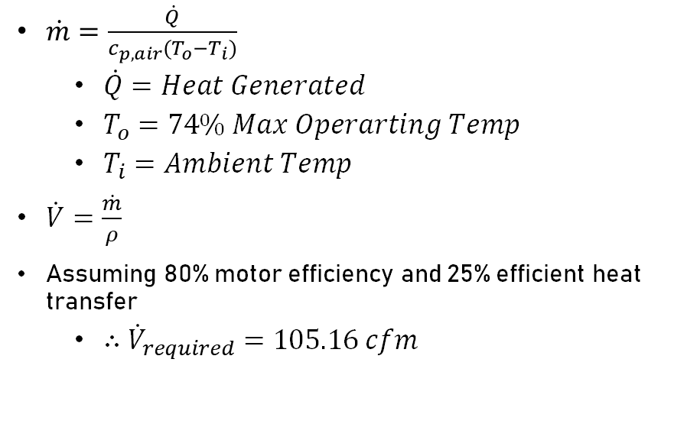
Actuator Table Basic Heat Analysis
Based on an estimated 80% motor efficiency
T_out chosen based on motor data sheet
Assumed 25% efficient convective heat transfer between motors and air
We need 105.16 cfm to cool the motors
2 fans on input and output for each compartment will be sufficient
$\dot{m}=\frac{\dot{Q}}{c_{p,air}(T_{o}−T_{i})}$
$\dot{Q}=Heat Generated$
$T_{o}=74\% Max Operarting Temp$
$T_{i}=Ambient Temp$
$\dot{V}=\frac{\dot{m}}{ρ}$
Assuming 80% motor efficiency and 25% efficient heat transfer
$∴{\dot{V}}_{required}=105.16 cfm$
Notes:
For the heat analysis of the table we started with some reasonable assumptions that would assume a worst-case scenario operating condition.
80% is a very low operating efficiency for the motors we are using,
The exit temperature was chosen to be 74% of the maximum operating temperature
And we assumed 25% effective convection heat transfer between the motors and the air
Using all of this we found that the volume flow rate we needed over the motors was about 105 cfm. With 2 fans on input and 2 on output for each compartment
We will achieve an airflow of 145.6 cfm in each compartment.
Additionally, the fans we have selected will only generate about 22.5 dB so they will be fairly quiet, particularly in endeavor

Slide 43
Future Tests
Motor testing
Shear testing
Testing the motion of the spline
Testing gear mesh
Notes:
Motor testing to see if it holds when running. Shear tests to see if the material will shear when the forces are being applied on the material.
Gear mesh test to see if the gears mesh and run well together
Motion of the spline to see if it operates accordingly to our design

Slide 44
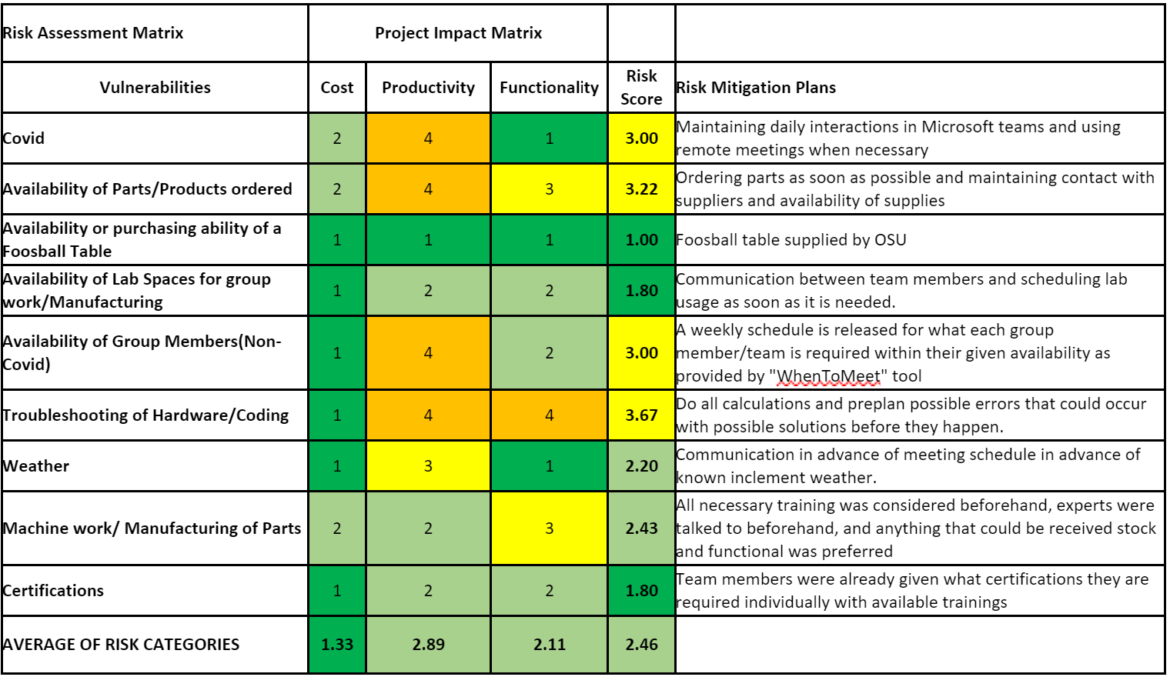
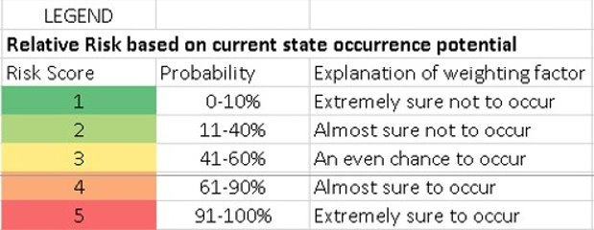
Risk Management Plan

Slide 45

Design Redundancy
Actions for mitigating the possible failure of the current mechanical design:
Recouple linear and rotational motion by returning to traditional belt and sled actuation.
Upgrade linear motors to account for increased loads.

Slide 46

Project Plan

Slide 47

Detailed Design Phase

Slide 48

Detailed Design Phase

Slide 49

Fabrication Phase

Slide 50

Fabrication Phase

Slide 51

Complete Documentation

Slide 52

Work Breakdown Overview
Slayter Teal
Overall Powerpoint Design, Software Overview, Vision and Perception, Graphical User Interface, and Project Plan
Jackson Law
Testing, Overall Mechanical Design, Motor Sizing, Gear Design
Jonathan Harris
Gantt Chart, EHS, Global/Ethical concerns, Mechanical Design, Actuator Table design/heat analysis, camera frame/housing design
Alex Rivera
Actuation CAD Design
Cole Mitchell
Software Standards, Server, FSM, and Software Testing

Slide 53

Work Breakdown Overview
Hunter Collins
Cad Models, Mechanical Design, Risk Assessment Analysis, Mechanical Codes and Standards
Michael Thompson
Controls, Communication, PCB, Power
Kenny Gipson
Gear tooth strength calculation, Materials, Fatigue calculations, FEA slide
Garrison Locke
Mechanical design for camera frame/mount and actuation table
Johnny Enriquez
Knowledge Acquisition, Cost Evaluation, Electrical Standards, Goal Tracking

Slide 54

Q&A

